Slide 1


CS3103 MACHINE LEARNING
STOCK PRICE MOVEMENT PREDICTION USING SOCIAL MEDIA SENTIMENT
Group ID: 25RC33

Slide 2
Roles & Responsibilities
Defined project scope, assigned tasks, integrated all modules, and oversaw report writing and submission.
Drafted methodology and results sections, visualized findings, and compiled final report and presentation.
Collected financial and sentiment datasets, cleaned and preprocessed data, and prepared train-validation splits.
Ankesh Kumar 2301CS06
Eshan Bhaskar
2301CS16
Krishan Kumawat 2301CS25
Implemented text cleaning, sentiment scoring (BERT), and generated sentiment-based features for modeling.
Built and tuned ML models, evaluated performance metrics, and compared sentiment vs price baselines.
Neetish Kumar 2301AI15
Raushan Raj 2301CS82

Slide 3

Introduction
Problem Statement
Stock market prices are dynamic and highly sensitive to multiple factors such as company performance, economic events, and public sentiment. With the rise of platforms like Twitter, investors frequently share opinions that can significantly influence short-term market movements.
Traditional prediction models mainly rely on historical and numerical data, overlooking the psychological and emotional dimensions that drive investor behavior. This limitation often reduces their ability to anticipate sudden price changes triggered by market sentiment.

Slide 4

Introduction
Motivation
Investor decisions are increasingly driven by online opinions and discussions.
Social media platforms like Twitter provide real-time insights into market sentiment.
Combining sentiment analysis with financial data can provide a competitive edge in forecasting market trends.
Helps investors and analysts make data-driven, sentiment-aware investment decisions.
Objectives
To collect and preprocess stock-related tweets and sentiment data.
To train machine learning and deep learning models to predict stock price movement based on sentiment.
To compare model performance using metrics such as accuracy and RMSE.
To demonstrate the influence of public sentiment on short-term stock market trends.

Slide 5

Literature Review
Key prior work
“BERT-based Financial Sentiment Index and LSTM-based Stock Return Predictability” (Hiew et al., 2019)– built a financial-sentiment index via BERT and used LSTM for stock returns; showed sentiment improves prediction.
“Financial Sentiment Analysis Using BERT with Application in Predicting Stock Movement” (Jiang Zeng, 2023)– applied BERT plus LSTM on a news dataset; sentiment found effective vs ARIMA
.
“Stock Price Prediction Using BERT-Enhanced Sentiment and Technical/Statistical Indicators” (2025)– combined BERT-based sentiment with technical/price indicators in a multimodal framework; showed short-term forecasting gains.

Slide 6

Literature Review
Gaps and our Contribution
Many studies focus on news articles / formal financial text; fewer incorporate social-media text (tweets/forums) capturing investor mood quickly
Few works utilise a sliding-window sequence of combined sentiment + technical indicators for time-series forecasting
Trading-strategy simulation (e.g., stop-loss / take-profit) post-prediction is rarely integrated in academic models
Domain-adaptation for informal investor language (social media) remains under-explored
Our contribution: We use tweet-level sentiment (via BERT), combine with technical indicators in a 20-day sliding window, and simulate trading strategy for a single stock (TSLA) to evaluate both accuracy and profitability

Slide 7

Literature Review
Citations
Hiew, J.Z.G. et al. (2019). BERT-based Financial Sentiment Index and LSTM-based Stock Return Predictability. arXiv:1906.09024
Ko, C.-R. Chang, H.-T. (2021). LSTM-based Sentiment Analysis for Stock Forecast. PeerJ Comput. Sci
Asgarov, A. (2023). Predicting Financial Market Trends using Time Series and NLP. arXiv:2309.00136
Liu, X. (2025). Tesla Stock Prediction Based on LSTM and News Sentiment Analysis. Atlantis Press
Chaudhary, R. (2025). Advanced Stock Market Prediction Using LSTM. arXiv:2505.05325
Polec, J. (2020). Stop-Loss, Take-Profit, Triple-Barrier & Time-Exit. Medium
Arnold, C. (2016). Stop-Loss in Trading Strategy. PythonProgramming.net

Slide 8

Methodology
Dataset
Source: Kaggle – Stock Tweets for Sentiment Analysis and Prediction (2015–2020)
Contains ~60,000 stock-related tweets with timestamps and sentiment labels
Stock price data retrieved using Yahoo Finance API and merged by date
Preprocessing
Text Cleaning: Removed URLs, mentions, hashtags, emojis, and punctuation
Tokenization & Lemmatization: Converted text into word tokens and base forms
Stopword Removal: Eliminated irrelevant words to improve sentiment accuracy
Sentiment Extraction: Used BERT for polarity scoring
Feature Engineering
Aggregated daily sentiment polarity
Sentiment merged with stock data based on date alignment
Normalized and time-aligned series using statistical scaling

Slide 9

Methodology
Proposed Method
Deep Learning Models:
1. LSTM : Captured temporal dependencies in tweet and price data
2.BERT: Extracted contextual sentiment embeddings from tweets
Fusion Layer: Combined sentiment and technical features for prediction
Output: Classified stock movement as Upward or Downward
Evaluation Metrics: RMSE, Accuracy
System Architecture
Data Layer: Collect tweets and stock data
Preprocessing Layer: Clean, tokenize, lemmatize, extract sentiment
Feature Layer: Combine sentiment + technical indicators
Model Layer: LSTM / BERT models for temporal and contextual learning
Output Layer: Predict next-day stock movement trend

Slide 10







Methodology
Flow Chart
Load Tweet Dataset (stock_tweets.csv)
Preprocess Text (lowercase, URLs/@/#, unicode, contractions, finance regex
Sentiment Analysis (BERT) ‘nlptown /bert base-multilingual-uncased-sentiment’
Aggregate Daily Sentiment (mean Sentiment_Score)
Load Stock Market Data (stock_y finance_data.csv
Preprocess Market Data (filter TSLA, parse dates)
Feature Engineering
(ma_20,z_score(7d))
Scale Data (StandardScaler) (z-score in preprocessing)
Train Model (100 epochs, Adam LR=1e-5, MSE, grad clipping)
Build Sequential Model (PyTorch LSTM: hidden=64, layers=2, dropout=0.2)
Create Sequences (lookback=20) + z-score scaling (features, target)
Merge Datasets on Date (align sentiment + market)
Predict & Evaluate (RMSE, Directional Accuracy)
Trading Simulation (stop-loss / take-profit)
End / Visualization (Price & Sentiment plots)

Slide 11

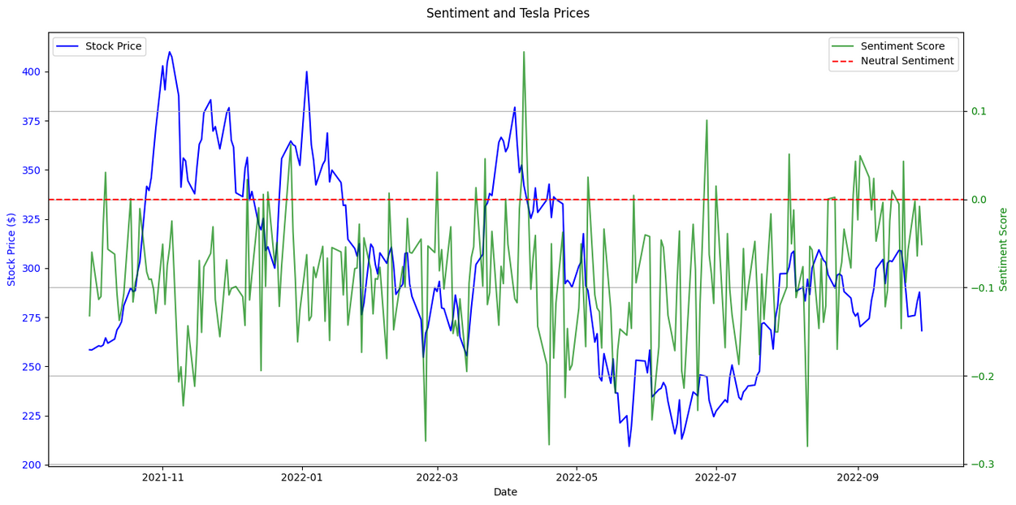
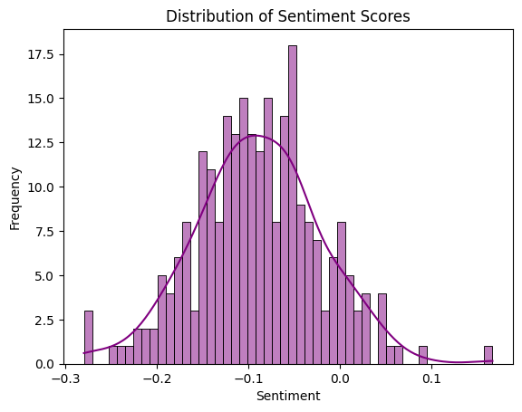
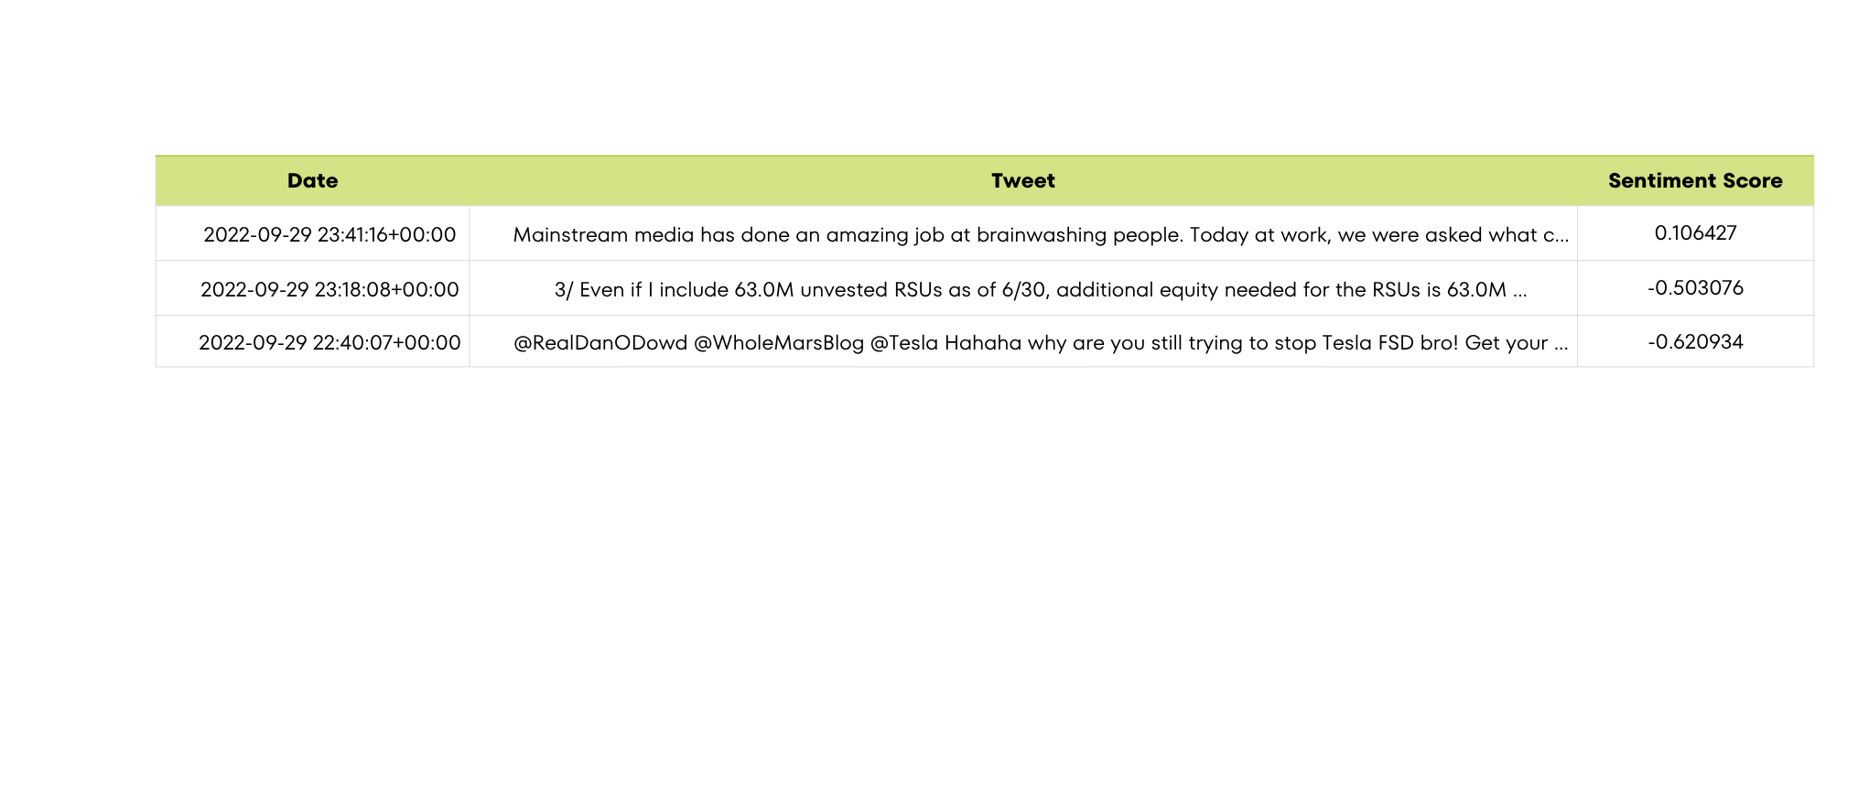
Result and Discussion

Slide 12

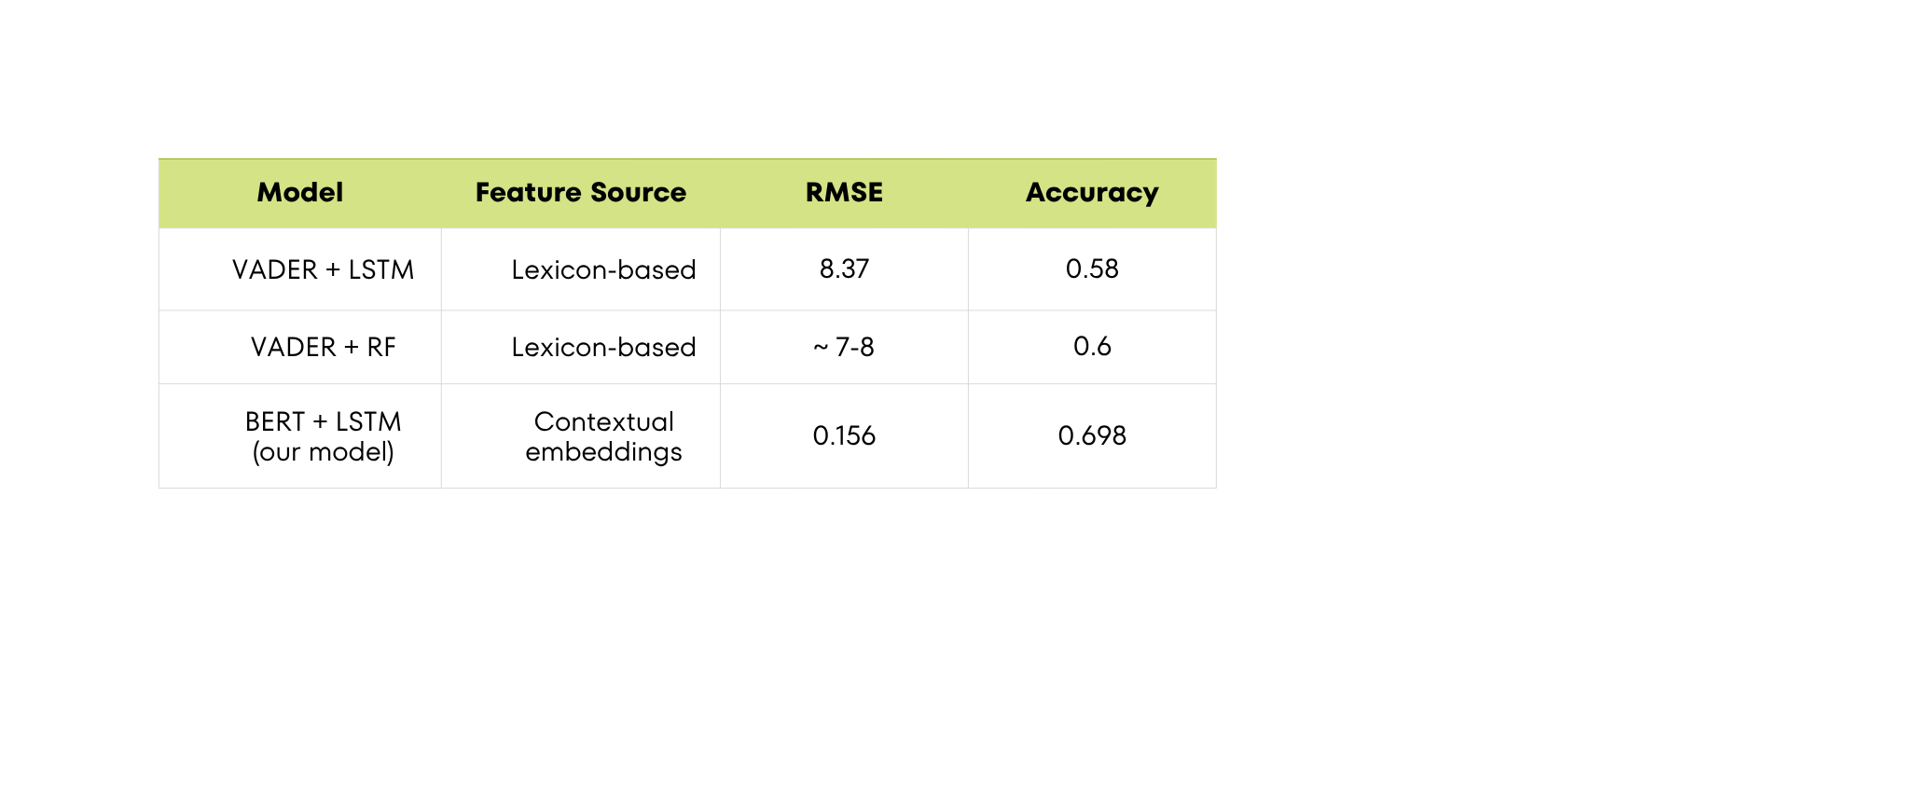
Result and Discussion
Comparison
Observations
BERT captures context: Understands semantics and sarcasm → better sentiment labeling.
LSTM captures temporal patterns: Learns tweet sequence effects on stock changes. Social media sentiment provides early cues for short-term stock price direction.
Traditional models miss nuance: VADER depends on predefined word lists → fails for domain-specific or sarcastic tweets.

Slide 13

Conclusion
Takeaways
The project successfully demonstrates that social media sentiment plays a significant role in influencing short-term stock price movement.
Deep learning models such as LSTM, and BERT effectively capture both temporal and contextual patterns between tweets and market trends.
Combining sentiment-based and technical indicators improved prediction accuracy compared to traditional price-only approaches.
The model can assist traders and analysts in making data-driven, sentiment-aware investment decisions.

Slide 14

Conclusion
Limitations
Data Imbalance: Stock classes had limited tweet coverage, leading to biased learning.
Real-time Implementation: Current setup processes pre-collected data; real-time prediction requires continuous tweet streaming and updating.
Noise in Tweets: Presence of sarcasm, slang, and irrelevant posts can affect sentiment accuracy.
Limited Market Scope: Experiments focused on a few stocks and may not generalize to all sectors or global markets.
Future Work
Integrate real-time Twitter API for continuous data collection and live predictions.
Expand dataset to include Reddit, StockTwits, and financial news for richer sentiment context.
Explore transformer-based hybrid models (e.g., FinBERT + LSTM) for improved feature fusion.
Implement a dashboard or web app for real-time stock sentiment visualization and alerts.

Slide 15

References
Research Papers
Liu, X. (2025). Tesla Stock Prediction Based on LSTM and News Sentiment Analysis. Atlantis Press
Asgarov, A. (2023). Predicting Financial Market Trends using Time Series and NLP. arXiv:2309.00136
Ko, C.-R., & Chang, H.-T. (2021). LSTM-based Sentiment Analysis for Stock Forecast. PeerJ Comput. Sci.
Hiew, J. Z. G. et al. (2019). BERT-based Financial Sentiment Index and LSTM-based Stock Return Predictability. arXiv:1906.09024
Chaudhary, R. (2025). Advanced Stock Market Prediction Using LSTM. arXiv:2505.05325
Hutto, C., & Gilbert, E. (2014). VADER: A Parsimonious Rule-based Model for Sentiment Analysis of Social Media Text. ACL
Kaggle (2024). Stock Tweets for Sentiment Analysis and Prediction. Dataset
Dataset
Tools / Frameworks
TensorFlow & PyTorch (2024). Deep Learning Frameworks. Official Docs
PyTorch.org

